Slide 1
Continuous Integration

Slide 2
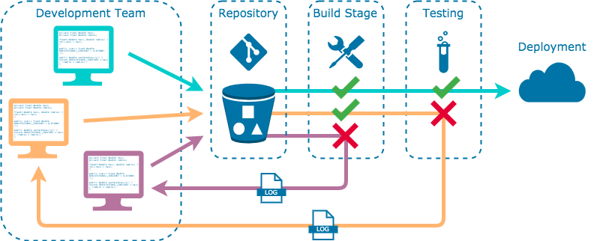
Continuous Integration
automated integration of code from many contributors into a single software project
allow developers to integrate newly-generated code easily and frequently
achieved through the use of automated testing tools to check the correctness of code before full integration

Slide 3
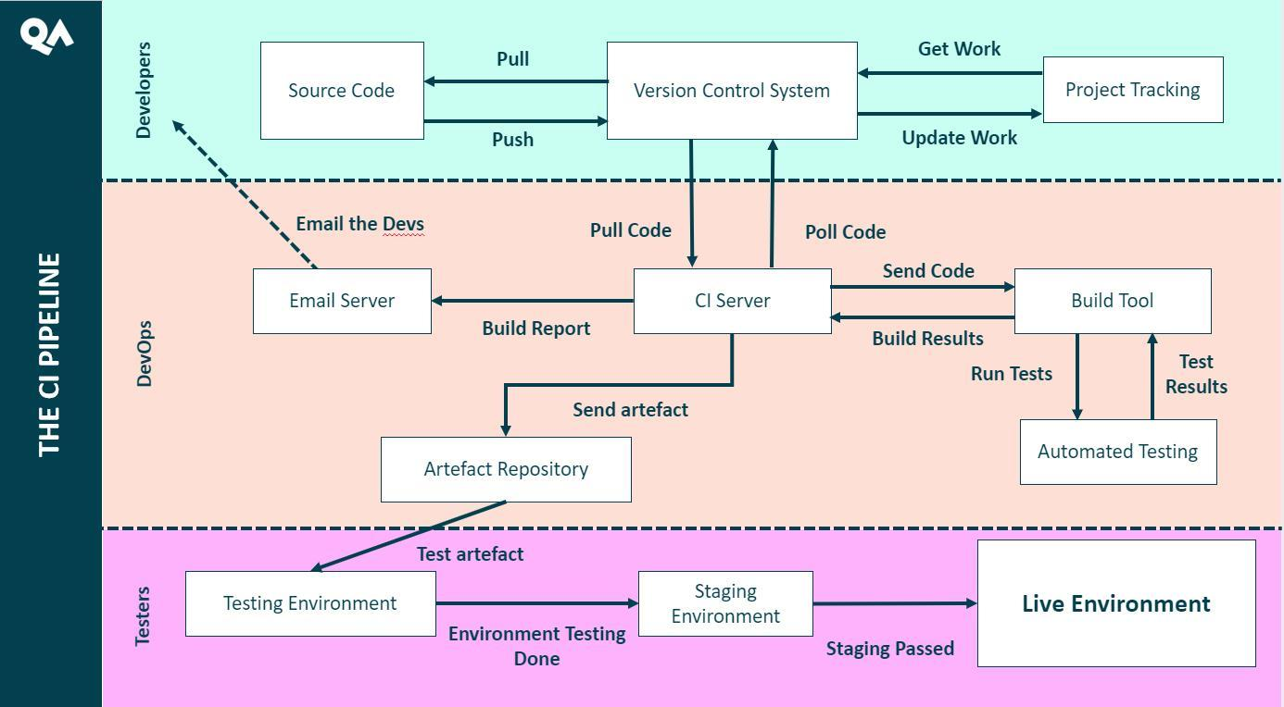
CI pipeline

Slide 4
CI Pipeline
A CI pipeline should:
Maintain a single source code repository for a project
Have a "master" branch that should always be ready to deploy
Keep all team members informed of every update to the source code
Automate build processes
Automate testing of new builds
Inform developers of test failures with detailed logs
Encourage smaller, frequent deployments of code

Slide 5
CI Pipeline
CI leverages many software tools to handle the automated building, testing, and deployment processes. The main steps in the CI pipeline include:
Code generation
Code repository
Building and testing

Slide 6
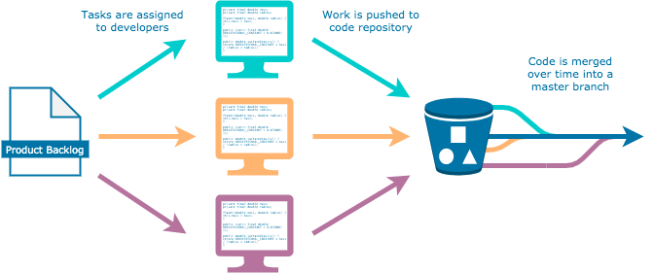
Version Control System
designed to track changes to code over time as contributors add new features to the application
allows for cohesive collaboration
ability to easily revert an application to a previous, stable state if new code breaks something

Slide 7
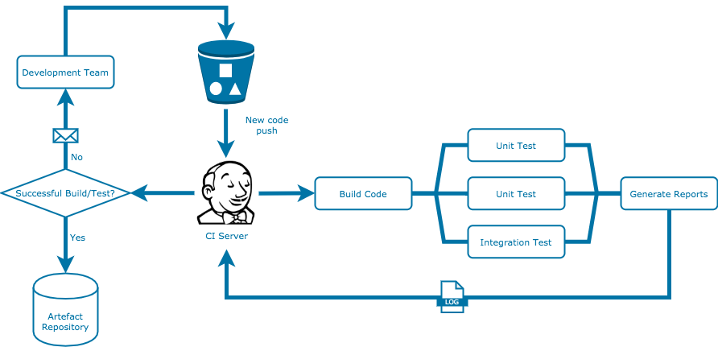
CI Server
handles all the automated building, testing, and deployment of code as it is pushed to the VCS
If a test or build fails, integration is halted and the developer is informed of where the code failed along with detailed reports

Slide 8
Benefits
Scaling
automating frees up time for developers to do other things
allows for scaling up the development team, code generation, code integration
Feedback Loop
gradual feature updates allow for more opportunities for business feedback
more client/customer feedback
rapid bug fixes
Communication
trackable changes enhances communication between teams
team members avoid stepping on each other’s toes
aids transparency of work across the organisation

Slide 9
Challenges
Installation and adoption
likely to be a long and involved process
potential to waste time, effort, and money should it be approached without enough planning
Learning curve
pipelines make use of many different and relatively new technologies that teams may not have any prior experience with
new workflow
some teams may find their old responsibilities obsolete and have to readjust their set of responsibilities

